Slide 1



MySQL Operators
Sai Vardhan T

Slide 2
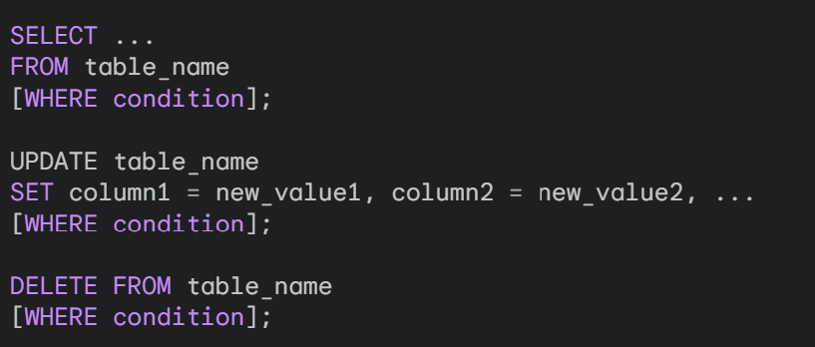
WHERE CLAUSE
The WHERE clause is a fundamental element of SELECT, UPDATE, and DELETE statements in MySQL.
It acts as a filter, allowing you to specify conditions that must be met for rows to be included in the query results or targeted for modifications.

Slide 3

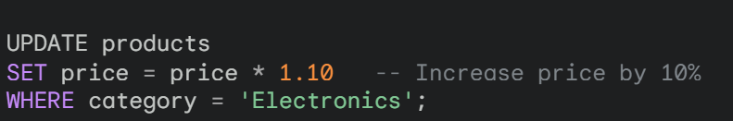
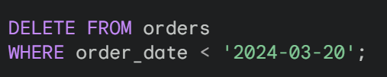
EXAMPLES FOR WHERE CLAUSE
SELECTING CUSTOMERS FROM A SPECIFIC CITY:
UPDATING PRODUCT PRICES BY CATEGORY:
DELETING ORDERS OLDER THAN SPECIFIC DATE:

Slide 4


USE OF ALIAS
You can use aliases with string functions to assign a more descriptive name to the result of the function. This enhances the readability and clarity of your queries, especially when dealing with complex expressions.
USING AS KEYWORD
OMITTING AS (OPTIONAL)

Slide 5
OPERATORS AND USAGE
Operators are special symbols or keywords used in MySQL to perform various operations on data, compare values, and control the flow of your queries.
Types of Operators
Arithmetic operators
Comparison Operators
Logical Operators
Stings Operators
Null Operators
Other Operators

Slide 6
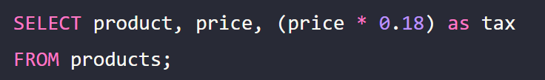
Arithmetic Operators
Perform basic mathematical calculations on numeric data types (e.g., integers, decimals).
+ (addition), - (subtraction), * (multiplication), / (division)
% (modulo - remainder after division)

Slide 7

Comparison Operators
Used to compare values and return TRUE or FALSE based on the comparison.
= (equal to),!= (not equal to)
< (less than), > (greater than), <= (less than or equal to), >= (greater than or equal to)
This retrieves customer records where the age is 18 or above.

Slide 8
Logical Operator
Combine multiple conditions within your WHERE clause or control the flow of control structures.
AND: Both conditions must be true for the row to be included.
OR: At least one condition must be true for the row to be included.
NOT: Inverts the logical state of a condition.
This retrieves electronic products with stock levels greater than 0.

Slide 9
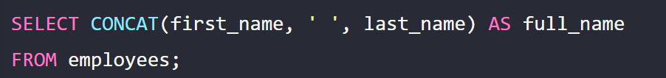
String Operators
Used for manipulating and comparing string data.
CONCAT (concatenates strings), SUBSTRING (extracts a substring), LENGTH (gets string length)
LIKE (pattern matching with wildcards - % for any characters, _ for a single character)
This retrieves customer records where the name contains the string "Smith" anywhere.

Slide 10
NULL Operator
Used for checking and handling NULL values (absence of a known data value).
IS NULL: Checks if a value is null.
IS NOT NULL: Checks if a value is not null.
This retrieves orders where the customer email is missing (null).

Slide 11
Other Operators
MySQL offers various additional operators for specific purposes.
BETWEEN: Checks if a value falls within a specific range.
IN: Checks if a value is present within a list of specified values.
CASE: Used for conditional expressions and assigning values based on conditions.

Slide 12
BETWEEN Operator
This retrieves all orders placed between March 15th, 2024 (inclusive) and March 20th, 2024 (inclusive).

Slide 13

IN Operator
This operator checks if a value exists within a specified list of values.
This retrieves customer records where the country is either 'USA', 'Canada', or 'UK'.

Slide 14
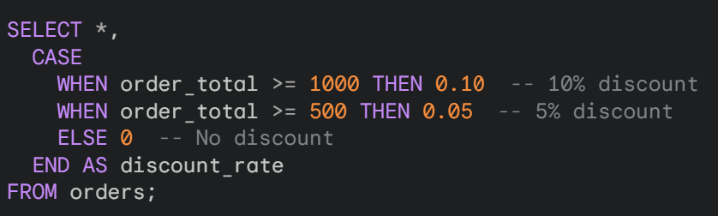
CASE Operator
This operator allows you to perform conditional checks and assign different values based on those conditions.
This adds a new column named discount_rate. It assigns a 10% discount for orders $1000 or more, a 5% discount for orders $500 or more, and no discount for orders below $500.

Slide 15
STRING FUNCTIONS
REVERSE
REPLACE
LIKE
USE OF ALIAS
CONCAT
CONCAT_WS
LOWER
UPPER
CHARACTER LENGTH
SUBSTRING

Slide 16
CONCAT
The CONCAT function in MySQL is a versatile tool for combining multiple strings into a single string. It allows you to concatenate various text values, columns, literals, and even expressions to create new strings within your queries.
SYNTAX:
CONCAT(str1,str2,....,strn)

Slide 17
EXAMPLES FOR CONCAT
Simple Concatenation of Two Strings:
This query concatenates the string "Hello, " with "world!" and assigns the result (greeting message) to the alias greeting.
Concatenating a Column with a Literal:
This query retrieves customer IDs and combines the first_name column with a space (" ") and the last_name column using CONCAT. The result is then aliased as full_name for clarity.

Slide 18
EXAMPLE FOR CONCAT
Concatenating with Expressions:
This example demonstrates concatenating the name column with a string literal, followed by the stock column value in parentheses using an expression. The result is aliased as product_info.

Slide 19
CONCAT_WS
In MySQL, the CONCAT_WS function stands for "Concatenate With Separator." It's a more versatile alternative to the CONCAT function when you want to combine multiple strings and specify a separator character between them.
SYNTAX:

Slide 20
EXAMPLES FOR CONCAT_WS
Concatenating Names with a Space Separator:
This query retrieves customer IDs and combines first_name with last_name, separated by a space using " " (space enclosed in quotes) as the separator. The result is aliased as full_name.
Creating File Paths with a Forward Slash Separator:
This example constructs image paths by concatenating the string 'images/', the product_code column, and the string '.jpg', using '/' (forward slash) as the separator. The result is aliased as image_path.

Slide 21
LOWER IN UPPER
The LOWER and UPPER functions in MySQL are fundamental tools for case manipulation of text data. They allow you to convert all characters in a string to lowercase or uppercase, respectively.
LOWER Function:
Purpose: Converts all characters in a string to lowercase.
Syntax:
LOWER(string)
UPPER Function:
Purpose: Converts all characters in a string to uppercase.
Syntax:
UPPER(string)

Slide 22
EXAMPLES FOR UPPER & LOWER
This query retrieves product names and creates a new column named lowercase_name by converting the original names to lowercase using LOWER.
This query retrieves customer emails and creates a new column named uppercase_email by converting the original email addresses to uppercase using UPPER.

Slide 23
CHARACTER LENGTH
There are two primary functions in MySQL to determine the length of a string:
LENGTH(): This function returns the number of bytes used to store the string in the database.
CHAR_LENGTH(): This function returns the number of characters in the string, considering multi-byte characters.
LENGTH() vs. CHAR_LENGTH(): Here's the key difference:
LENGTH(): Counts the total bytes used to store the string. This value might not directly reflect the number of characters if multi-byte characters are present.
CHAR_LENGTH(): Counts the actual number of characters in the string, considering multi-byte characters appropriately.

Slide 24
EXAMPLES OF CHARACTER LENGTH
Finding Byte Length of a String (ASCII):
This query assumes an ASCII character set. It retrieves product names and calculates their byte length using LENGTH(). Since ASCII uses one byte per character, byte_length will likely match the actual character count.
Finding Character Length with Multi-Byte Characters (UTF-8):
This query assumes a UTF-8 character set, which can handle characters from various languages. It retrieves customer names and calculates their character length using CHAR_LENGTH().

Slide 25

SUB STRING
The SUBSTRING function in MySQL is a versatile tool for extracting a portion (substring) from a given string.
SYNTAX:
string: This is the original string from which you want to extract a substring.
start_position: This is a positive integer that specifies the starting position (index) within the string where the extraction should begin. The first character in the string is at position 1.
length (optional): This is an optional argument that specifies the number of characters to extract from the starting position. If omitted, the function extracts characters from the starting position till the end of the string.

Slide 26
EXAMPLES OF SUBSTRING
Extracting the First Five Characters:
This query retrieves product names and extracts the first five characters (from position 1) using SUBSTRING(product_name, 1, 5). The result is assigned to the alias first_five.
Extracting a Substring from Any Position:
This example extracts everything from the 7th position (assuming space after the first name) onwards using SUBSTRING(customer_name, 7). This effectively retrieves the last name assuming a typical first name-last name format.

Slide 27
EXAMPLE OF SUBSTRING
Extracting Up to a Certain Length:
This query extracts the first three characters (from position 1) using SUBSTRING(product_code, 1, 3), assuming the first three characters represent the product category code.

Slide 28
REVERSE
The REVERSE function in MySQL is used to reverse the order of characters within a string. It's a straightforward function that provides a quick way to manipulate text data.
SYNTAX:
REVERSE(string)
string: This is the text value or expression you want to reverse.

Slide 29

EXAMPLE FOR REVERSE
This query retrieves customer names and creates a new column named reversed_name by reversing the original names using REVERSE.
Output:
The output will display the customer names in reverse order (e.g., "Smith John" becomes "nhoJ htimS").

Slide 30
REPLACE
The REPLACE function in MySQL is a powerful tool for modifying strings by replacing all occurrences of a specific substring with another substring. It allows you to perform targeted text replacements within your queries.
Syntax:
REPLACE(string, old_substring, new_substring)
string: This is the original text value or expression where you want to replace substrings.
old_substring: This is the substring you want to find and replace within the string.
new_substring: This is the substring you want to insert in place of each occurrence of the old_substring.

Slide 31
EXAMPLES FOR REPLACE
Replacing Typos:
This query corrects a typo ('teh' instead of 'the') in product descriptions. It replaces all occurrences of 'teh' with 'the' using REPLACE.
Removing Substrings:
This query removes hyphens ('-') from phone numbers. It replaces all occurrences of '-' with an empty string ('') using REPLACE.

Slide 32
LIKE
The LIKE operator is used in a WHERE clause to search for a specified pattern in a column.
There are two wildcards often used in conjunction with the LIKE operator:
The percent sign % represents zero, one, or multiple characters
The underscore sign _ represents one, single character

Slide 33


EXAMPLES FOR LIKE
Select all customers that starts name with a
Return all customers from a city that starts with 'L' followed by one wildcard character, then 'nd' and then two wildcard characters:

